Slide 1
Real-Time Vehicle Detection from captured images Sneha Kothi 1911024

Slide 2

Project analysis slide 2
Project Analysis
INTRODUCTION
CONCLUSION
PROJECT
ARCHITECTURE
RESULT
IMPLEMENTATION
TESTING

Slide 3
INTRODUCTION
Real-time image capture and detection is one of the subjects of research which gained focus rather than conventional areas of image processing due to its immense possibility of industrial detection.
Data captured at real-time has immense opportunity to analyze vehicle density, motion detection, and moreover, reading plate numbers of vehicles.
Among the various algorithms used by neural networks, Yolo algorithm is favored for this specific purpose, as it has already proved to be beneficial for several image capturing purposes, and also to extract the data for further analysis.
Objective of this paper is to primarily detect moving vehicles from real-time captured images.
Application:
detecting the number of vehicles that are present at a road at a certain point
Understanding the motion of the vehicles
Analyzing vehicle density at any traffic signal at any specified point of time; and based on our previous knowledge can make a good assumption where the vehicle will be heading towards.

Slide 4
ARCHITECTURE
In this paper, we have to detect common objects which are seen day-to-day, for which OpenCV DNN module is used along with trained YOLO model.
We use the YOLO algorithm to detect vehicle from images. YOLO (You Only Look Once) can detect any object from an image-we are specifically using it for vehicle detection here.
YOLO algorithm gives a much better performance with a high fps for real-time usage.
YOLO algorithm is an algorithm based on regression, instead of selecting the interesting part of an Image, it predicts classes and bounding boxes for the whole image in one run of the Algorithm.

Slide 5
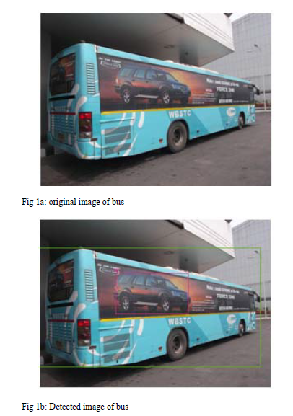
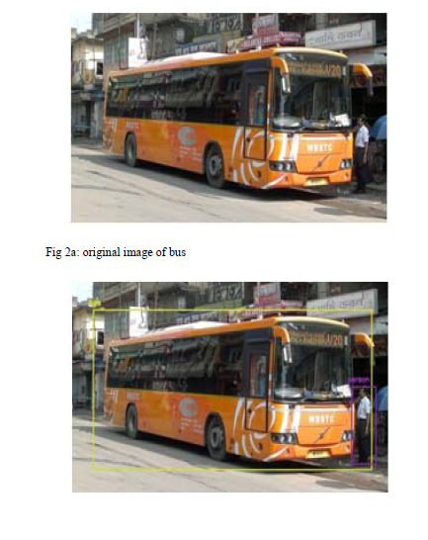
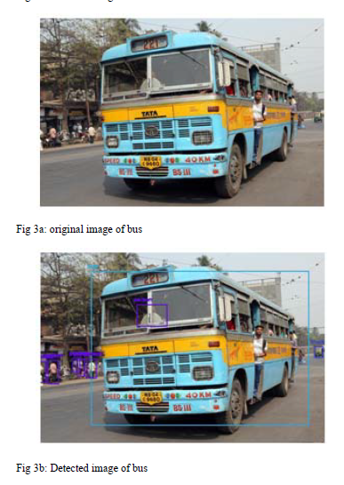
Project analysis slide 8
Result
Fig 2b: Detected image of bus

Slide 6
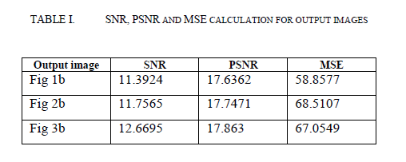
CONCLUSION
This algorithm is capable in detecting vehicles with a very high sense of precision and also detects nearby people as pedestrians who are willing to cross roads or are just passerby.
SNR of all the detected images are very close, and the same conclusion can also be applied for MSE. Detecting both vehicles and pedestrians in a transportation system is crucial.
Analysis is justified through the error table where we have computed SNR, PSNR and MSE for all the output images.

Slide 7
BIBLIOGRAPHY
https://en.wikipedia.org/wiki/Peak_signal-to-noise_ratio#:~:text=Peak%20signal%2Dto%2Dnoise%20ratio%20(PSNR)%20is%20an,the%20fidelity%20of%20its%20representation.
https://en.wikipedia.org/wiki/Mean_squared_error
https://en.wikipedia.org/wiki/Signal-to-noise_ratio#:~:text=Signal%2Dto%2Dnoise%20ratio%20(,the%20level%20of%20background%20noise.
https://towardsdatascience.com/yolo-you-only-look-once-3dbdbb608ec4

Slide 8
Implementation strategy
Create a dataset with random images of vehicles
Apply YOLO Algorithm for vehicle detection
Show the detected vehicle on Screen and save the detected image in working directory

Slide 9
Thank You

